Slide 1

We Inspect: The Home Health Impact (Team A - Fungis )
AI Studio Final Presentation
Breakthrough Tech Los Angeles @ UCLA
December 8th 2023

Slide 2

Introductions

Slide 3

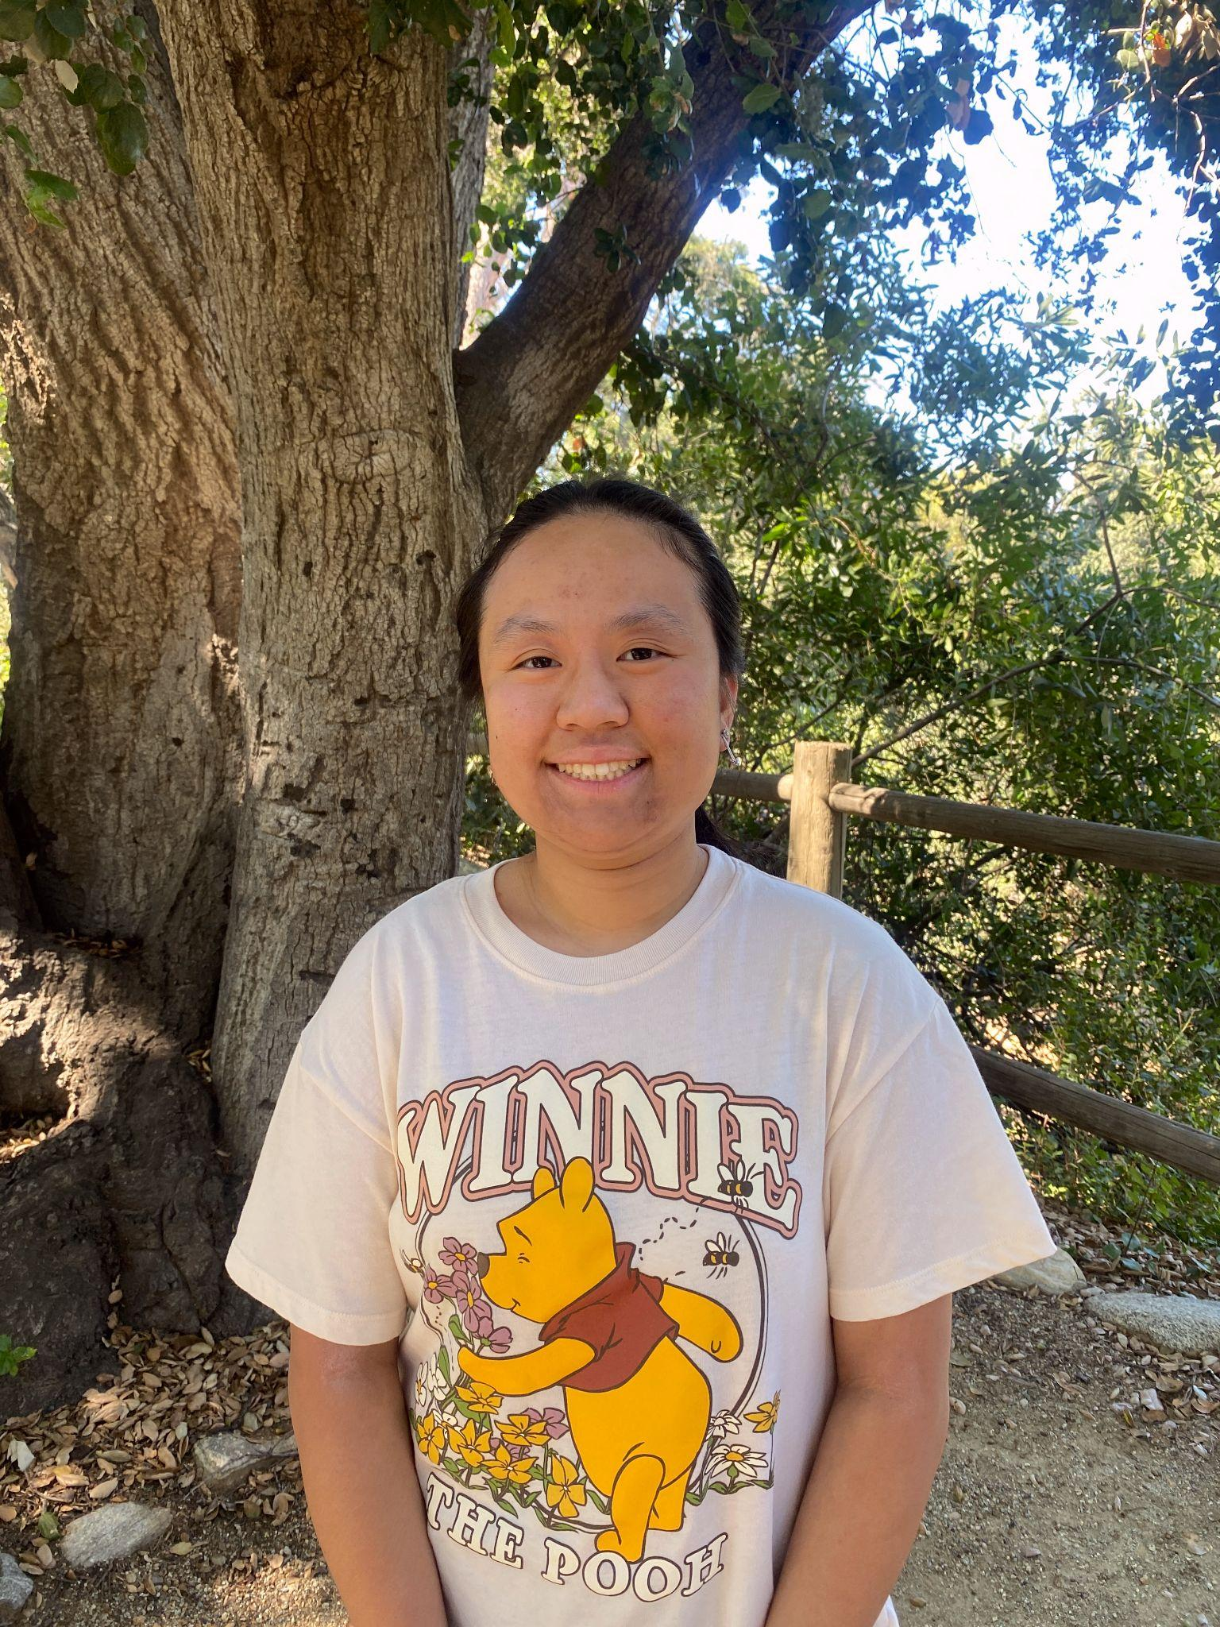



Meet Our Team!
Tiffany Truong Cal Poly Pomona
Ilda Martinez
California State University - San Bernardino
Max Ju California State University - Long Beach
Megan Kang California State University - Long Beach
Ayelet Kleinerman Pomona College

Slide 4


Our AI Studio TA and Challenge Advisor
<insert jpg>
Swagath Babu AI Studio TA
Corey Levy Challenge Advisor

Slide 5
AI Studio Project Overview

Slide 6
“
Using unsupervised & supervised learning models to predict mold species in your homes that are potentially linked to symptoms
Notes:
What type of ML challenge?
This is a unsupervised clustering problem.
What type of data were you dealing with?
Using company-provided data in csv format obtained from anonymous surveys conducted by said company.
What did your team find interesting or compelling about the challenge?
- We were driven by the impacts of this project. What gravitated us to this project was hearing the stories of people affected by mold in their homes without their knowledge and how this project takes a step forward in helping those with ailments that are potentially caused by mold.

Slide 7
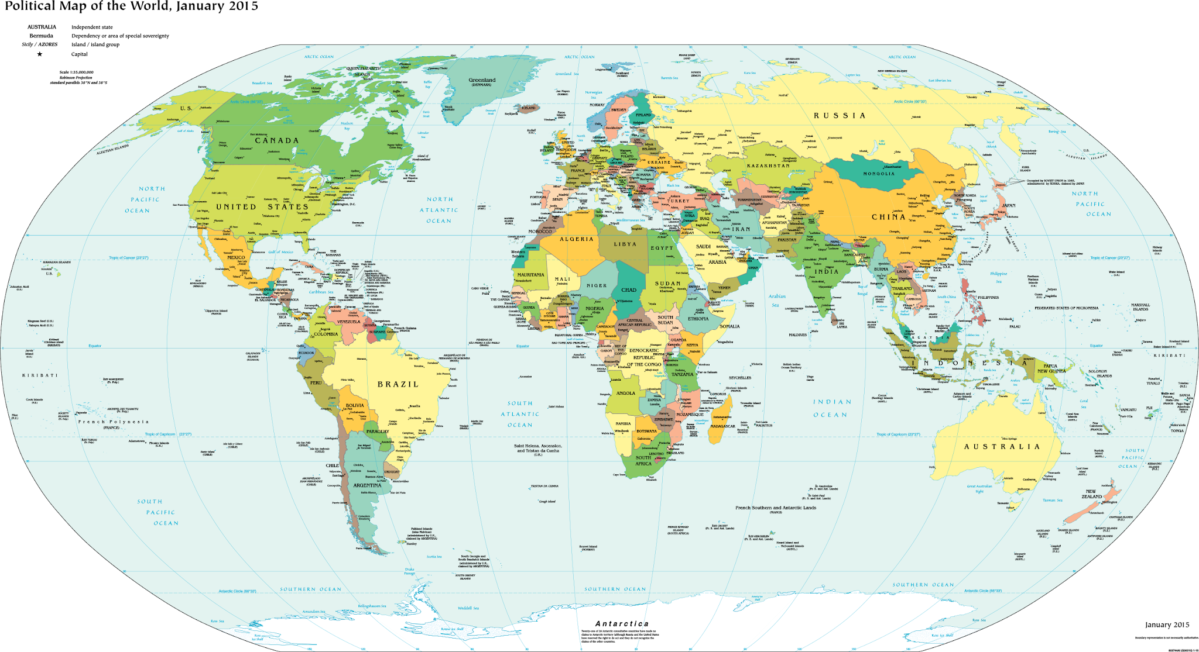
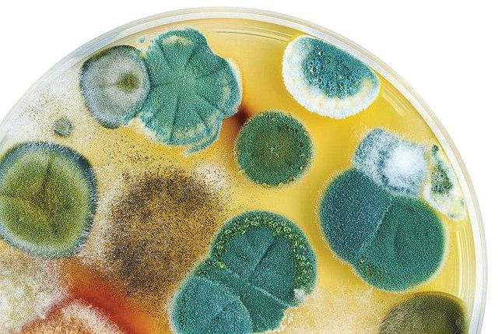
Our Goal
Finding the optimal model for predicting mold species from symptoms
Draw correlations and conclusions between mold types and symptoms
Improve our model to incorporate other factors from the dataset such as location and diagnoses
Notes:
- Find the optimal model for predicting symptoms from mold species
- Draw correlations and conclusions between mold types and symptoms
- Improve our model to incorporate other factors from the dataset such as location and diagnoses

Slide 8

Business Impact
Public & Practitioners
Keeping homes and families safe from mold
Spread awareness about possible mold types in homes to people who are facing health symptoms
Notes:
- We worked with the co-owner of WeInspect.
- This project directly impacts the goals of the company in keeping homes safe.

Slide 9
Our Approach
Getting to know our team!
Familiarizing ourselves with the team, challenge advisor, and AI Studio TA. Logistics; communication, scheduling, official introduction to the project, first look at the dataset and creating a development plan.
Modeling and Evaluating and Testing
After researching various unsupervised clustering and association models, we begin attempting to implement them. Comparing results through tabulated data, graphs, and other visualizations.
Sept-Oct
Nov-Dec
Aug-Sept
Oct-Nov
Data Understanding and Preparation
Getting deep into understanding the data presented to us and what we want to predict from this dataset. Figuring out what we need and what we don't. Finding important features and cleaning the data of any discrepancies. Begin researching models to help us better prepare our dataset.
Wrapping it up!
Completing documentations of our accomplishments and drawbacks. Jotting down what we learned and the steps we took to develop this project. Gathering our insights and collaborations to present our findings and hardwork.

Slide 10









Resources We Leveraged
Notes:
Used Google Colab
Python Libraries: Scikit Learn, Pandas
Tools/Resources: Dataset via Google Sheets/Excel (csv file) + The Dust Test ERMI Results
Other Resources: Kaggle, eCornell, Github, Stackoverflow, Youtube videos

Slide 11
Data Understanding & Data Preparation

Slide 12
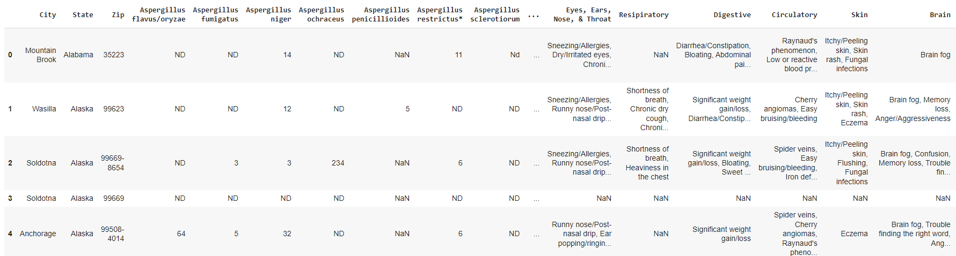
Data Overview
Given to us by We Inspect (CSV File: ERMI Code + Health Symptoms.csv)
Data is provided anonymously from US & International patients via a form
There are around 600 data points:
Columns: City, State, Zip Code, Mold Types, ERMI Code, Diagnoses & Symptoms
Numerical & Categorical Data

Slide 13
Data Cleaning
Create consistency in the data
Change all non-numeric values and blanks as 0
Remove Asterisks (*)
One-hot encode symptoms
Handling various issues such as:
Separation by commas
Remove white spaces in ‘City’ column
Dropping empty columns (‘Unnamed: 42’, ‘Unnamed: 43’)
Dropping columns with no variance - all values the same (‘Health Concerns?’ - Yes)
Standardizing the mold types - for K-Prototypes Clustering
Notes:
- Creating consistency in the data:
- Ne','ND','nd','Nd','N/D','<1','NF','Hh','Hhh','na','ne','o','O','NE','BD & Blank = 0
- Removing *
- One hot encoding symptoms
- Handling various issues such as:
- separation by commas however, in the data there is symptoms like ex. symptom(ect, ect, ect,)
- Removing whitespaces (in City names)
- Dropping empty columns
- Dropping columns with no variance (all rows were the same)

Slide 14
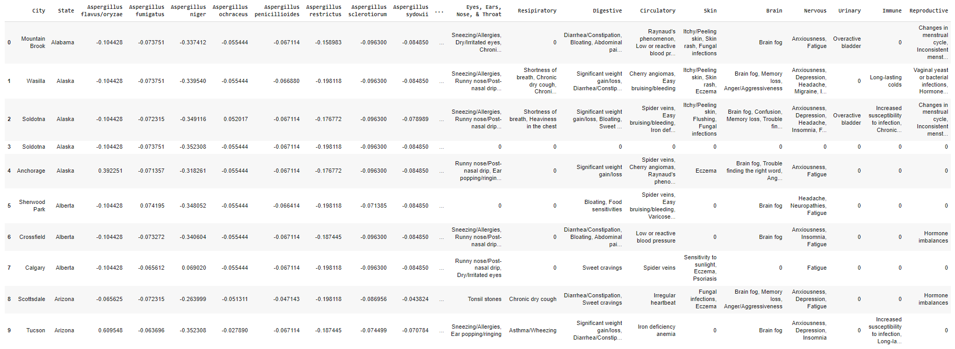
Data Cleaning
Notes:
- Creating consistency in the data:
- Ne','ND','nd','Nd','N/D','<1','NF','Hh','Hhh','na','ne','o','O','NE','BD & Blank = 0
- Removing *
- One hot encoding symptoms
- Handling various issues such as:
- separation by commas however, in the data there is symptoms like ex. symptom(ect, ect, ect,)
- Removing whitespaces (in City names)
- Dropping empty columns
- Dropping columns with no variance (all rows were the same)

Slide 15
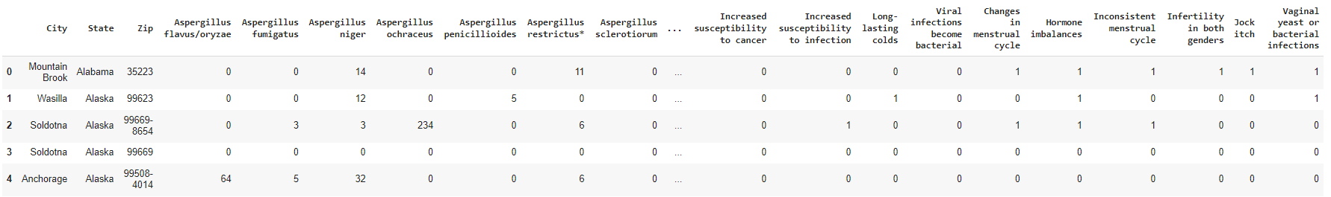
Data Cleaning
Notes:
One-hot encoding for KPrototypes Clustering

Slide 16
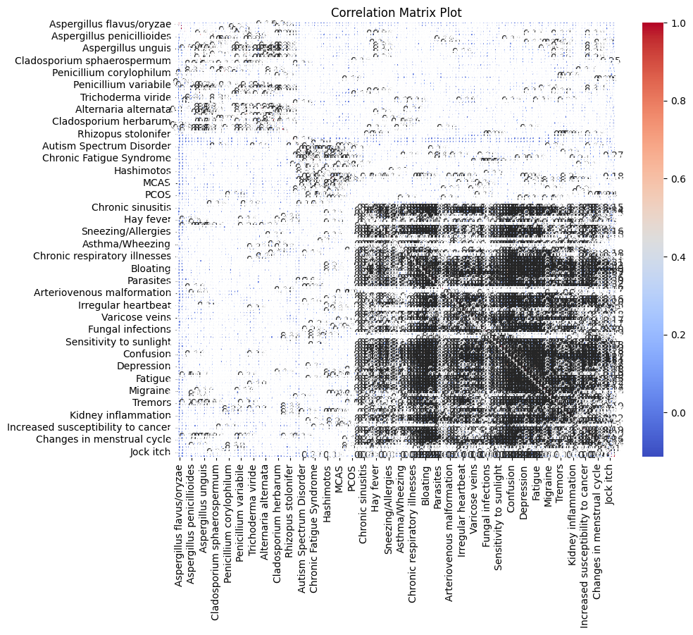
Correlation Analysis
Notes:
- Heat map

Slide 17
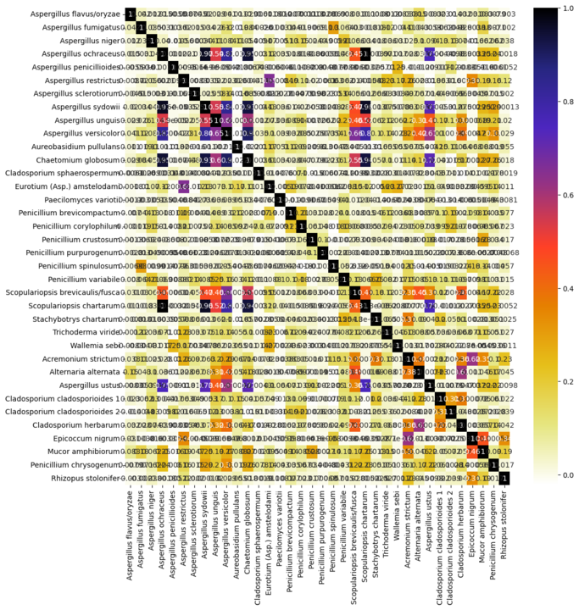
Correlation Analysis
Notes:
- Heat map

Slide 18
Data Preprocessing - PCA & t-SNE
Dimensionality Reduction Techniques
Principal Component Analysis (PCA)
t-Distributed Stochastic Neighbor Embedding (t-SNE)
Apply these techniques before we started implementing our models
Our Goal
Identifying important features (symptoms) by condensing our high-dimensional dataset to a low-dimensional graph while retaining trends and patterns
PCA
Linear transformation
Identifies the most significant variant
t-SNE
Non-linear embedding
Preserves pairwise similarities
Notes:
Apply these techniques before we look into clustering

Slide 19
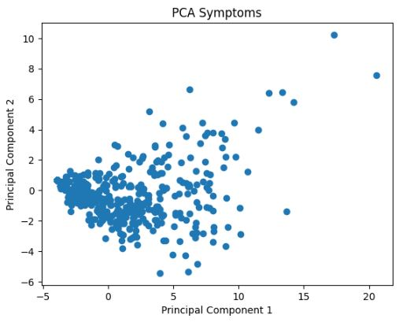
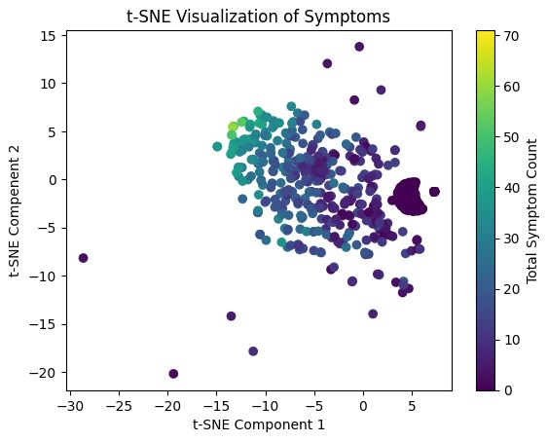
t-SNE Scatter Plot
PCA Scatter Plot
Notes:
For pca, we can view the variance in the data. The x axis is principal component 1 which represents the most significant variability, and the y axis is principal component 2 which is the 2nd most. Points that are closer in the graph are more similar. We had trouble finding the categories to differentiate and identify any clusters.
For t-SNE, we are capturing non-linear relationships between data points. We categorized the points by total symptoms in the data, so those with similar amount of symptoms were closer together in the plot. We can see that when there was less than 10 symptoms faced, they formed a cluster meaning they were similar. Some clusters also formed for 10 to 30 symptoms faced. And any that was above 30 symptoms were closer together in that top left.

Slide 20
Modeling & Evaluation

Slide 21
Algorithm Research and Selection
Unsupervised Learning Algorithms: Analyze and cluster unlabeled datasets
K-Means → K-Prototypes: Works with numerical and categorical data
Association Rule Learning
Models
Support Vector Machine (SVM)
We want to understand the pattern using clustering algorithms, before knowing what to predict and which model to use
Notes:
Algorithm Selection:
- KMeans
- PCA
- KPrototypes
- SVM
- Associated Rule Learning
- t-sne

Slide 22

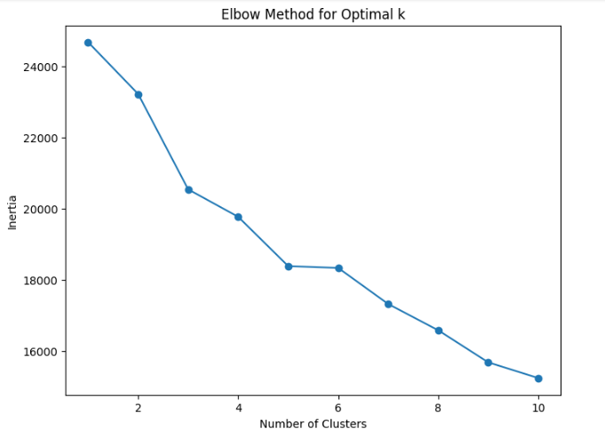
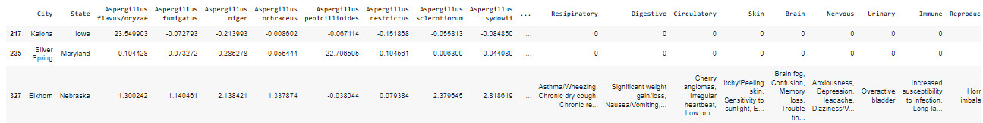
K-Means → K-Prototypes
K-Prototypes = Works the best for a dataset that has numerical and categorical data
To find the best optimal k for clustering:
Elbow Method
Silhouette Score (-1 ≤ x ≤ 1)
Closer to +1 is better!
Since the dataset is pretty big, it’s hard for us to see the clusters - finding the optimal k deems a challenge

Slide 23
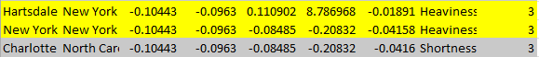
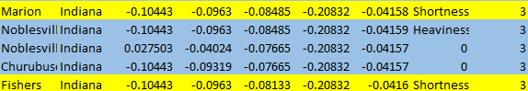
K-Prototypes
State, City
Mold Types: Aspergillus flavus/oryzae, sclerotiorum, sydowii, unguis
ERMI Code (Group I - Group II)
Respiratory - Shortness of Breath, Heaviness in the Chest
Clusters (0-4)
Notes:
Difficult to analyze, working on how to predict it
First version – lots of improvement to be done
Take a few columns of mold types to look at

Slide 24
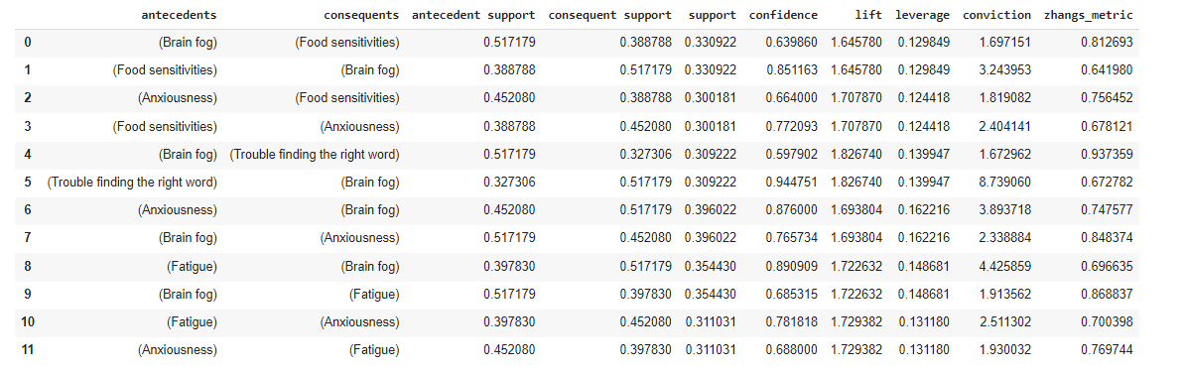
Association Rule Learning
Mapping the symptoms into pairs using Apriori Algorithm
e.g. ‘Trouble finding the right word’ and ‘Brain Fog’ are symptoms that may fall under the same type of mold (Confidence: 0.944751)

Slide 25
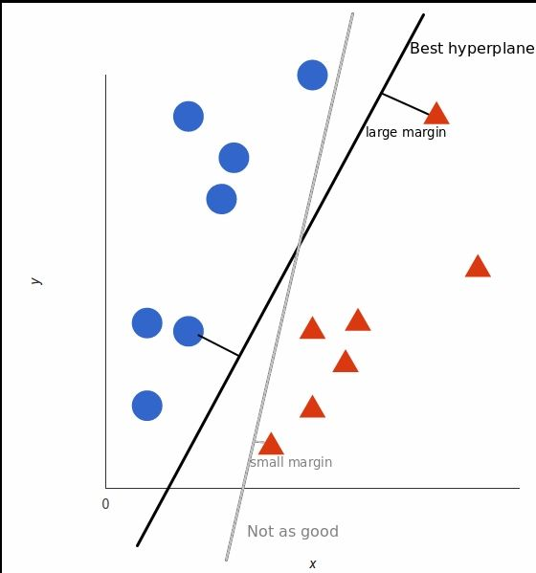
SVM Model
Supervised machine learning algorithm used for classification and regression tasks. It works by finding a hyperplane that best separates data points into different classes.

Slide 26
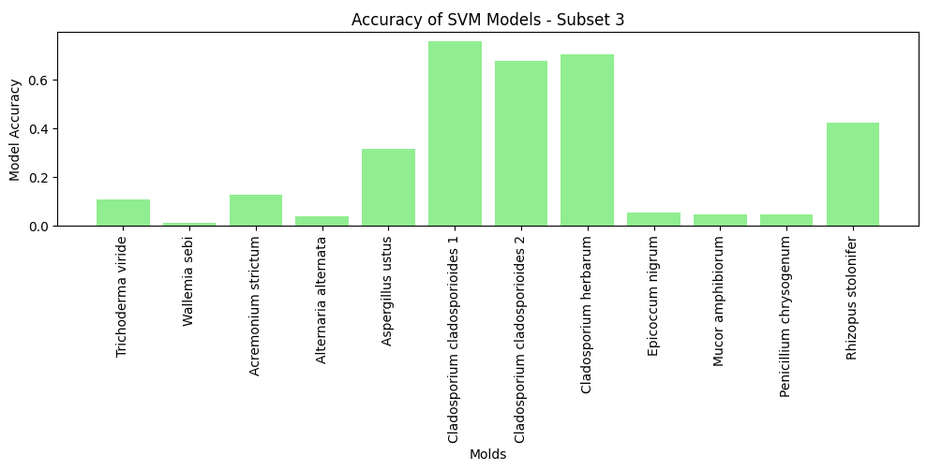
SVM Model
Dataset without Y

Slide 27
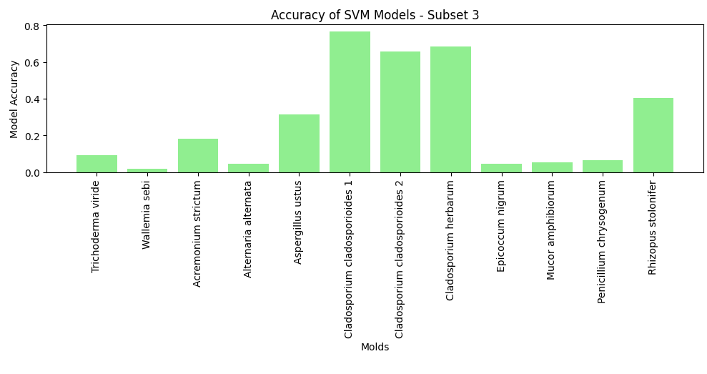
SVM Model
Symptoms only Features

Slide 28
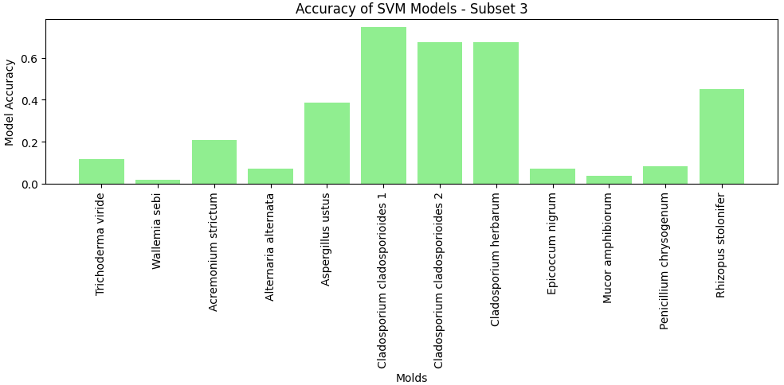
SVM Model
Symptoms with PCA

Slide 29
Model Comparison
Model Name | Description | Results | Pros | Cons
K-Prototypes | Unsupervised learning clustering algorithm to handle categorical and numerical data | TBD | Works the best with categorical and numerical data | Difficult to find the optimal k - using Silhouette Score & Elbow Method
Association Rule Learning | Unsupervised learning technique that checks for the dependency of one data item on another data item → mapping them together | Pairing of symptoms may have some correlation in same type of mold | Simple to understand No need for labeling | High sensitivity to noise Limited in handling continuous variables
SVM | Supervised machine learning algorithm used for classification and regression tasks | Strong predictive ability for certain molds | Strong prediction for particular molds with high dimensions of features | Computationally expensive Difficult interpretability

Slide 30
Insights and Key Findings
People who say that they have specific symptoms (e.g. Trouble finding the right word or Brain Fog) may have similar mold types in their homes that may be affecting their health
Shown in Association Rule Learning
Currently, working on these algorithms that we discussed to find better correlations/visualizations for more accurate results.

Slide 31
Final Thoughts

Slide 32
What We Learned
Unsupervised Learning
Python Libraries
KModes
New ML Concepts:
K-Prototypes, K-Means Clustering
Association Rule Learning
Principal Component Analysis (PCA), t-Distributed Stochastic Neighbor Embedding (t-SNE)
SVM (Support Vector Machine) Learning

Slide 33
Potential Next Steps
Improve our current models for better results and accuracy
Analyze which model results in the best accuracy
Using what we know from K-Prototypes, Principal Component Analysis (PCA), Association Rule learning, Support Vector Machines (SVM) and more, we will look into clustering/visualizations that would aid us in better results

Slide 34

Questions?

